Slide 1




www.propshop.org.in/apex-splendour

Slide 2
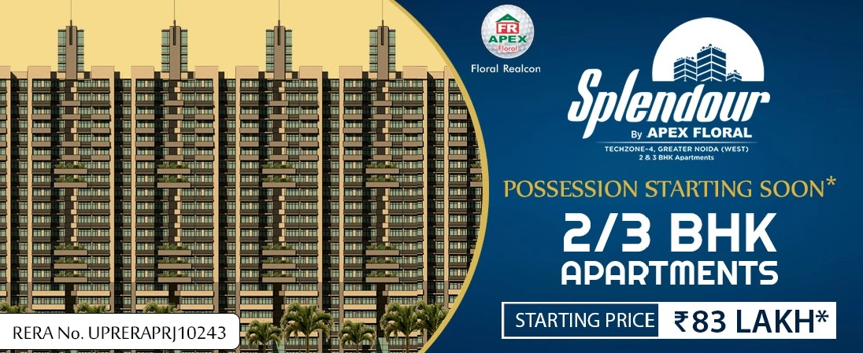

Slide 3
Apex Splendour Greater Noida West
The Ultimate Destination for Luxury Apartments
One of the most luxury projects that Floral Realcon has brought for the buyers is “Apex Splendour” in Techzone 4 of Greater Noida West. This project offers 2/3 BHK luxury Residential Flats. Many reputed Design Partners have come together to bring this Exclusive Luxurious Dream Home into reality to up-bring the quality lifestyle for the buyers. Currently, this project “Apex Splendour” is under construction and offer possession in 10 month.

Slide 4
Floor Plan
2 BHK + 2 Toilets Area Size: 1061 Sq. Ft.
2 BHK + 2 Toilets + Study Room-Area Size: 1153 Sq. Ft.
2 BHK + 2 Toilets -Area Size: 1237 Sq. Ft.
2 BHK + 2 Toilets + Study Room-Area Size: 1320 Sq. Ft.
3 BHK + 2 Toilets -Area Size: 1458 Sq. Ft.
3 BHK + 3 Toilets + Servant-Area Size: 1619 Sq. Ft.
2 BHK + 2 Toilets Area Size: 1061 Sq. Ft.
2 BHK + 2 Toilets + 1 Study Roo-Area Size: 1153 Sq. Ft.
3 BHK + 2 Toilets -Area Size: 1458 Sq. Ft.
3 BHK + 3 Toilets + 1 Servant-Area Size: 1619 Sq. Ft.

Slide 5
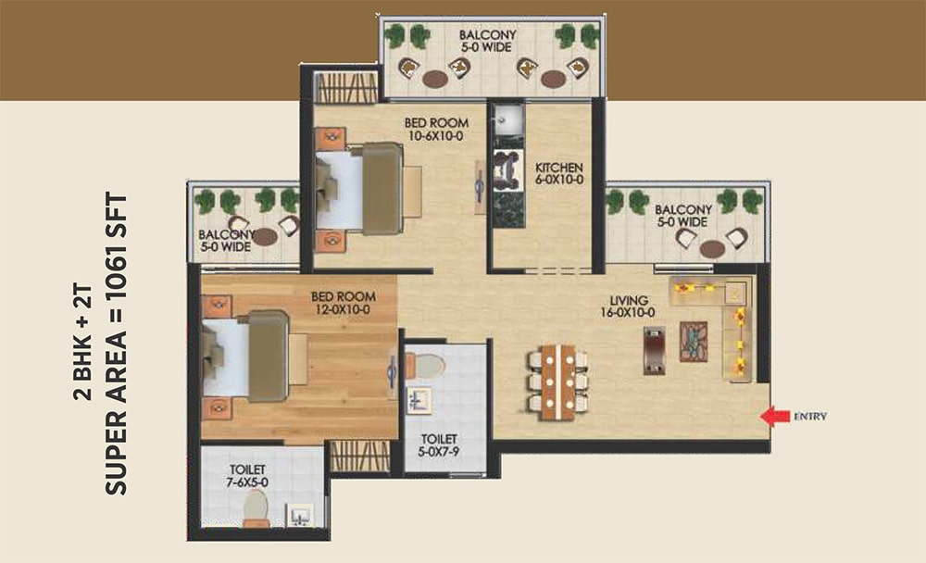
Floor Plan
1061 Sq. Ft

Slide 6
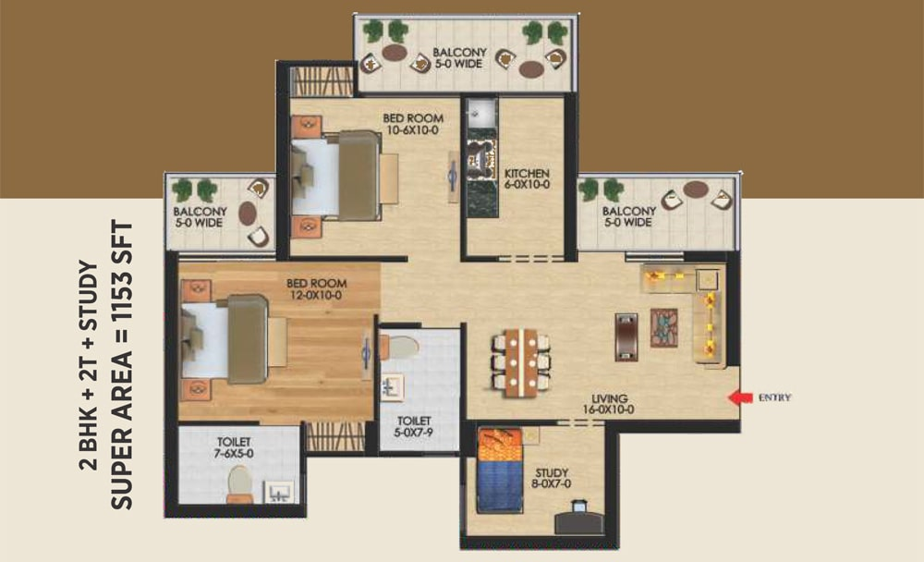
Floor Plan
1153 Sq. Ft

Slide 7
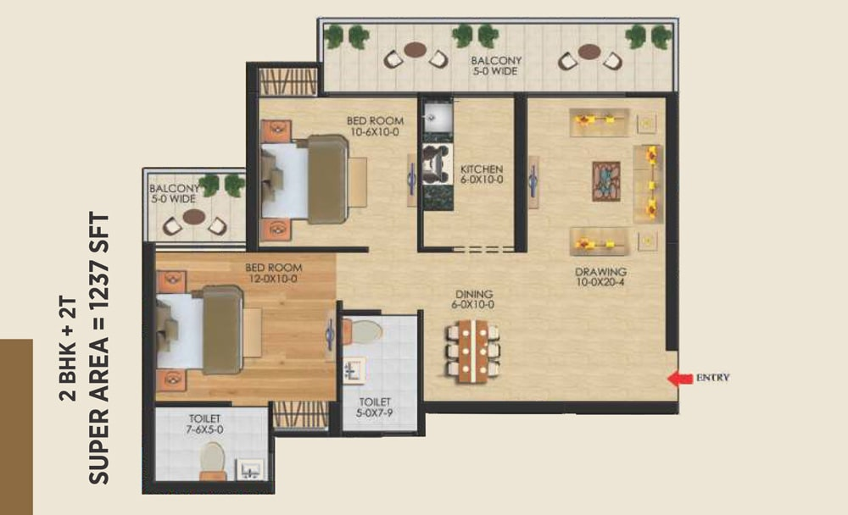
Floor Plan
1237 Sq. Ft

Slide 8
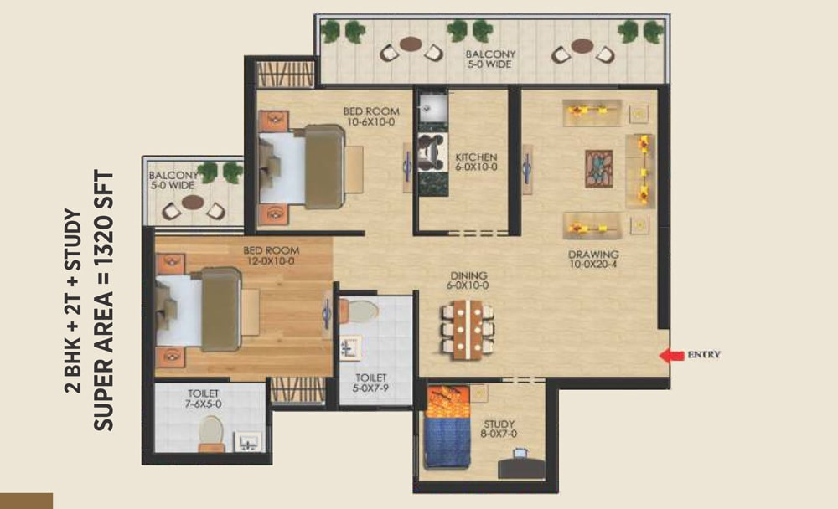
Floor Plan
1320 Sq. Ft

Slide 9
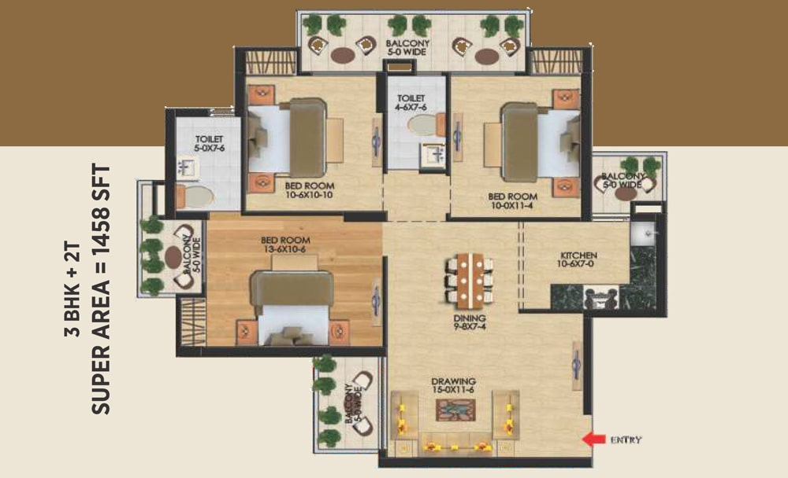
Floor Plan
1458 Sq. Ft

Slide 10
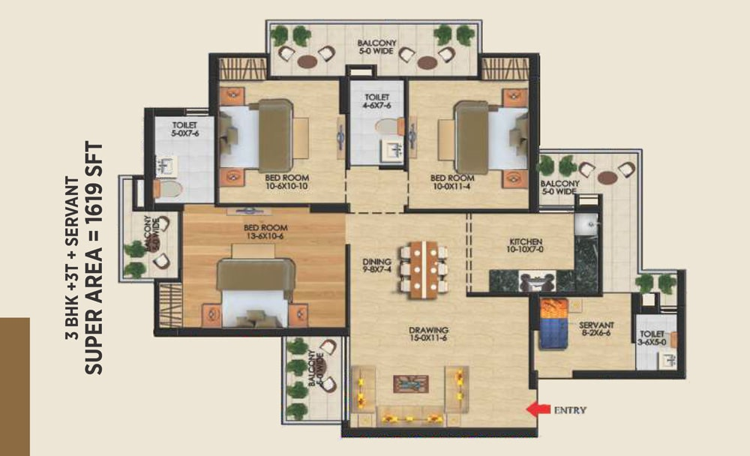
Floor Plan
1619 Sq. Ft

Slide 11
Project Highlights
2&3BHK Luxury Apartments.
Possession Soon.
Located in Techzone 4 of Greater Noida West.
A Dream Home by Apex Floral.
Inbuilt Shopping Plaza.
Prime Location and awesome view due to low density.
Landscaped Garden, Park, etc.
Fun Park, Kids Zone, Badminton, Basketball etc.
24/7 Hi-Tech Security, Water, Power etc.
RERA No.: UPRERAPRJ10243
2&3BHK Luxury Apartments
Possession Soon.
Located in Techzone 4 of Greater Noida West
A Dream Home by Apex Floral
Inbuilt Shopping Plaza.
Prime Location and awesome view due to low density.
Landscaped Garden, Park, etc.
Fun Park, Kids Zone, Badminton, Basketball etc.
24/7 Hi-Tech Security, Water, Power etc.
RERA No.: UPRERAPRJ10243.

Slide 12
Location Benefits
One of the popular commercial hubs in Greater Noida West, Techzone 4 is home to Artha SEZ & Airvil Intellicity.
NSEZ, Sector-132 and Sector-62 Noida are other commercial hubs from this locale within 12-14 km.
The area is located in proximity to Taj Highway, which further provides access to NH-24.
Popular schools such as Ryan International, Pacific World School & Sarvottam International School.
About 3-4 km from Yatharth Multispecialty & NIX Multispecialty hospitals.
Provides immediate access to Gaur City Mall, whereas Logix City Centre is located at a distance of 9 km.
Techzone 4 is only 13 km from Ghaziabad Railway Station via Taj Highway.
Indira Gandhi International Airport is located at a distance of 40 km from Techzone 4 via Barapullah Setu.
2&3BHK Luxury Apartments
Possession Soon.
Located in Techzone 4 of Greater Noida West
A Dream Home by Apex Floral
Inbuilt Shopping Plaza.
Prime Location and awesome view due to low density.
Landscaped Garden, Park, etc.
Fun Park, Kids Zone, Badminton, Basketball etc.
24/7 Hi-Tech Security, Water, Power etc.
RERA No.: UPRERAPRJ10243.

Slide 13
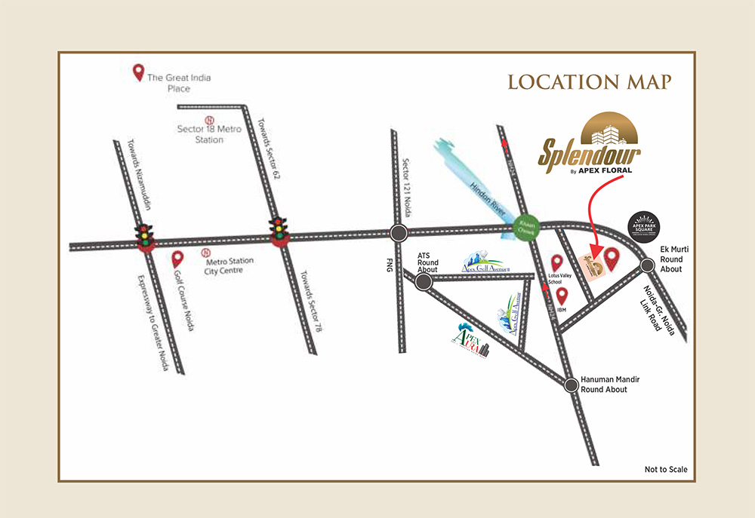
LOCATION MAP

Slide 14
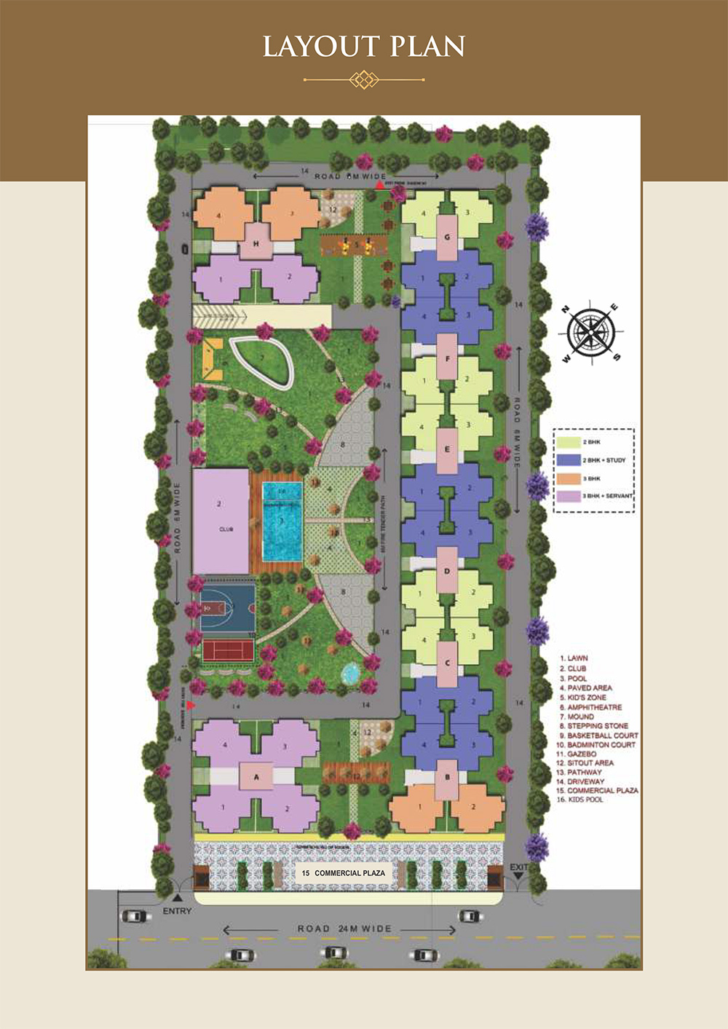
SITE PLAN

Slide 15

THANK YOU
www.propshop.org.in
CALL US : +91 9643353535

