Slide 1
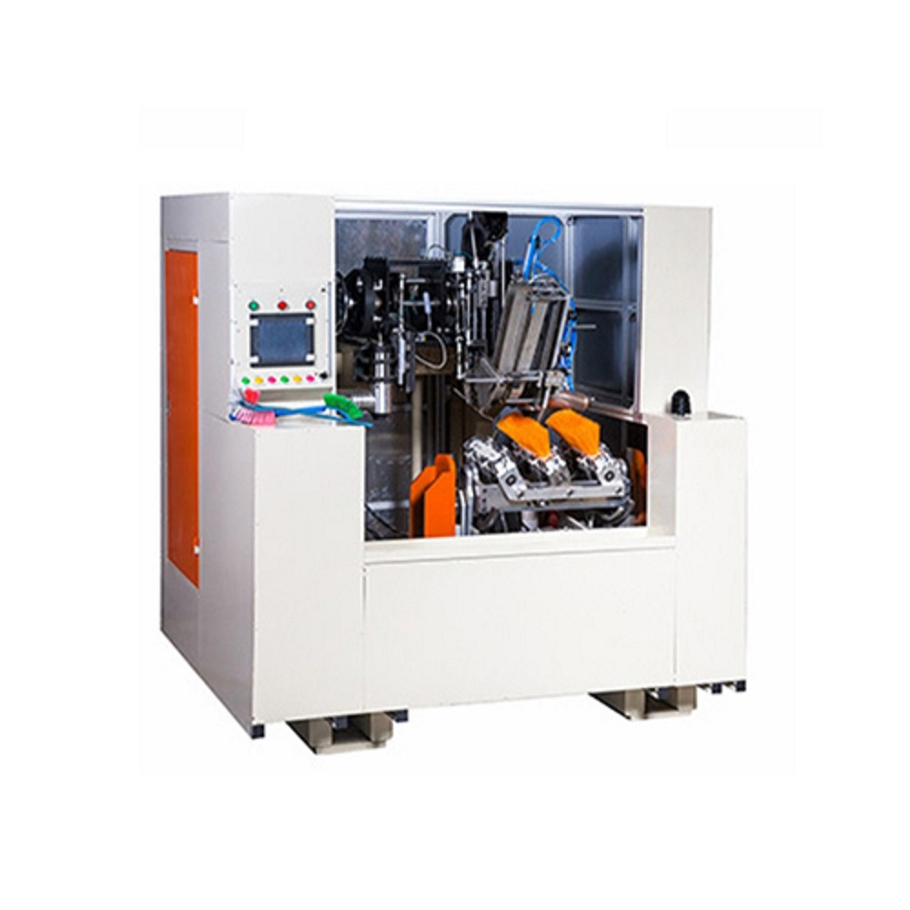

Sharma & Sons
Brush Tufting Machine Manufacturer
& Supplier

Slide 2
About Us
Sharma & Son’s is a leading manufacturing, Suppling high quality range of brush tufting machine.
A brush tufting machine is a specialized piece of equipment used for the automated production of brushes.
It is designed to insert tufts or bundles of bristles into a brush base or backing material.
The tufting machine's operation is typically controlled by a control panel or computer interface, allowing operators to set parameters such as tufting speed, bristle length, and tufting pattern. The automation and precision offered by brush tufting machines enable efficient and consistent production of brushes in various industries, including cleaning, cosmetics, industrial applications, and art.
Types of brush tufting machine are shown in next slide.

Slide 3
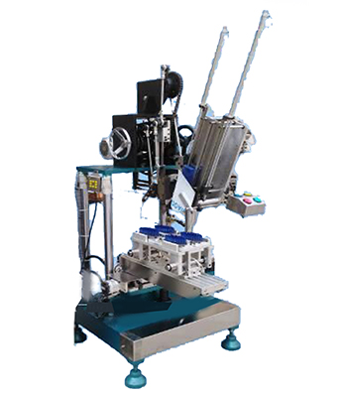
Our Products
If you are thinking to buy 2 Axis Brush Tufting Machine then you are at right place. Sharma & Sons is leading Brush Making Machine manufacturing company. The term "2-axis" describes a machine's capacity to move in two dimensions, usually horizontal and vertical, giving the user fine control over the arrangement and density of the tufts on the brush surface. Brush tufting machines are industrial machines used to automate the process of tufting, which involves inserting bristles or filaments into brush bases or surfaces. Contact us now wholesale quantity brush machine available.
2 Axis Brush Tufting Machine

Slide 4
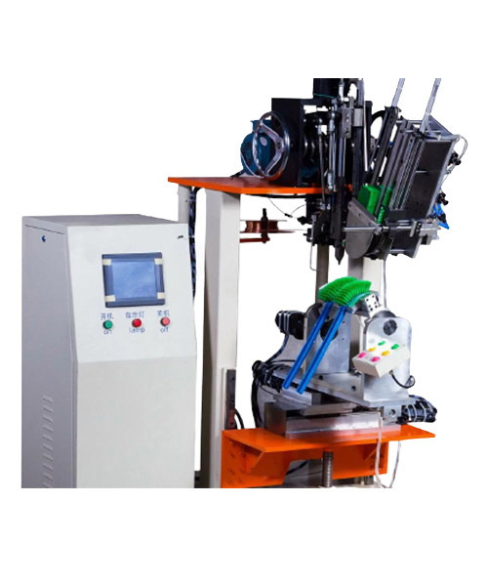
Sharma & Sons has specialized team for manufacturing 3 Axis Brush Tufting Machine. We are leading manufacturer of brush making machine located at India. Contact us now wholesale quantity brush tufting machine available.
3 Axis Brush Tufting Machine

Slide 5
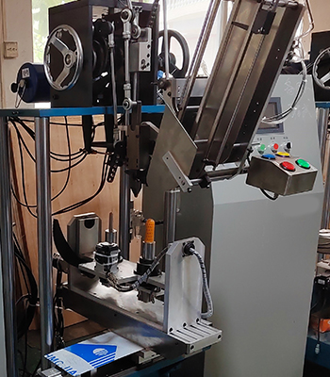
Sharma & Sons has specialized team for manufacturing 4 Axis Brush Tufting Machine. We are leading manufacturer of brush making machine located at India. A Double Hockey Cleaning Brush Tufting Machine is a specialized piece of equipment used for manufacturing hockey cleaning brushes, which are designed to clean the toilet surface in hockey rinks.
4 Axis Brush Tufting Machine

Slide 6
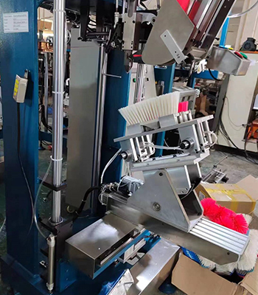
If you are thinking to buy 5 Axis Brush Tufting Machine then you are at right place. Sharma & Sons is leading Brush Tufting Making Machine manufacturing company. A 5-Axis Brush Making Machine is an advanced and versatile piece of equipment used for manufacturing a wide range of brushes, including those used for cleaning, grooming, painting, and other applications.
5 Axis Brush Tufting Machine

Slide 7
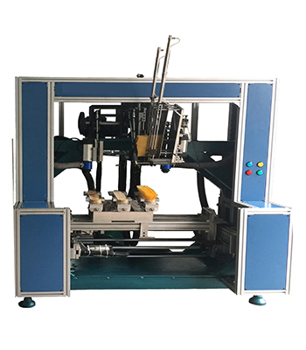
We are specialized in the research, development and manufacturing Drilling And Tufting Machine. Contact us now for more details. A Drilling and Tufting Machine for brooms is a specialized piece of equipment used in the manufacturing of broom heads.
Drilling and Tufting Brush Machine

Slide 8
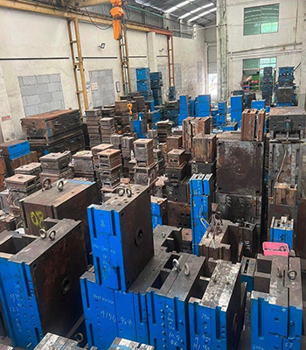
If you are thinking to buy Plastic Injection Mould Machine then you are at right place. Sharma & Sons is leading Plastic Injection Mould Machine manufacturing company. A plastic injection mold, also known as an injection molding tool or die, is a specialized tool used in the plastic manufacturing process to produce plastic components and products.
Plastic Injection Mould

Slide 9
Contact Us
Phone : +91 98370 30603
Email : sharmasons.agra@gmail.com
ADDRESS : B-329 B Block Shastripuram Yojna Sikandra, Agra.
FACEBOOK : https://www.facebook.com/SharmaSons.agra/
YOUTUBE : https://www.youtube.com/@sharmasons

